Slide 1
Looker Ecommerce Data Warehouse
Business Insights Using SQL Data Warehouse & Power BI
End-to-End Analytics Solution
February 2026
Mustafa Mahmoud Mohamed

Slide 2
Project Overview
Objective
To analyze e-commerce sales data, identify business problems, and provide actionable insights through a comprehensive data warehouse and interactive Power BI dashboard.
Scope & Tools
Raw e-commerce data (7 tables, 100K+ records) • SQL Server for ETL & DWH • Power BI for visualization • Medallion Architecture (Bronze/Silver/Gold) • Galaxy Schema design
Project Workflow
Raw Data
EDA
DWH
Dashboard
💡

Slide 3
Business Problem & Key Questions
Why This Project Matters
E-commerce success depends on understanding customer behavior, optimizing product mix, and identifying profitable markets. This project transforms raw transactional data into strategic intelligence.
Sales & Revenue Questions
Customer & Marketing Questions
• What is the annual profitability trend (2020-2024)?
• How are sales distributed across price ranges?
• Which countries generate highest revenue?
• Which brands have the highest sales volume?
• What is the monthly profit distribution?
• What is the customer conversion rate?
• Which traffic sources are most effective?
• What is the demographic distribution?
• Which browsers are most commonly used?
• What percentage never completed a purchase?

Slide 4
Data Collection
Data Sources
Data Characteristics
Kaggle
Looker Ecommerce BigQuery Dataset
7 Core Tables
users, orders, order_items, products,
inventory_items, events, distribution_centers
Volume
84,000+ customers, 100,000+ events
Attribute | Value
Total Customers | 84,000+
Countries | 74
Cities | 2,900+
Time Period | 2019-2024
Events Tracked | 100,000+
Data Quality Challenges Identified
Missing Values: NULL user_ids (13K+ rows), NULL product names/brands
Duplicates: Duplicate users (same email+name), duplicate event sequences per IP
Inconsistencies: Mixed data types (float IDs), non-standard values (M/F), string dates
Business Rule Issues: Multiple order statuses (Processing, Cancelled, Shipped) requiring filtering

Slide 5
Exploratory Data Analysis (EDA)
Systematic investigation to identify data quality issues and patterns
EDA Methodology
Top EDA Insights
Schema Inspection
sp_help for structure, data type validation
NULL Analysis
Count NULLs per column, identify critical gaps
Duplicate Detection
GROUP BY + HAVING, business key analysis
Distribution Analysis
Distinct counts, statistical summaries (MIN, MAX, AVG)
Relationship Validation
Foreign key integrity, orphaned records
Age Distribution
Average customer age: 40-50 years
Gender Split
Nearly equal Male/Female distribution
Geographic Coverage
74 countries, 2,900+ cities worldwide
Product Categories
Multiple brands & departments identified
Data Quality Score
15% of records require cleaning

Slide 6
Data Warehouse Design
3-Layer Medallion Architecture: Bronze → Silver → Gold
BRONZE
SILVER
GOLD
Raw Data Layer
• Minimal transformation
• SELECT INTO from source
• Historical preservation
• 7 unClean_* tables
Cleaned Data Layer
• Type standardization
• Duplicate removal
• NULL handling
• Date parsing
• Business rules
Dims:
• Dim_Date
• Dim_Product
• Dim_Customer
• Dim_Distribution_Center
• Dim_Browser
• Dim_Traffic_Source
Facts:
• Fact_Customer_Journey
• Fact_Inventory
• Fact_Sales

Slide 7
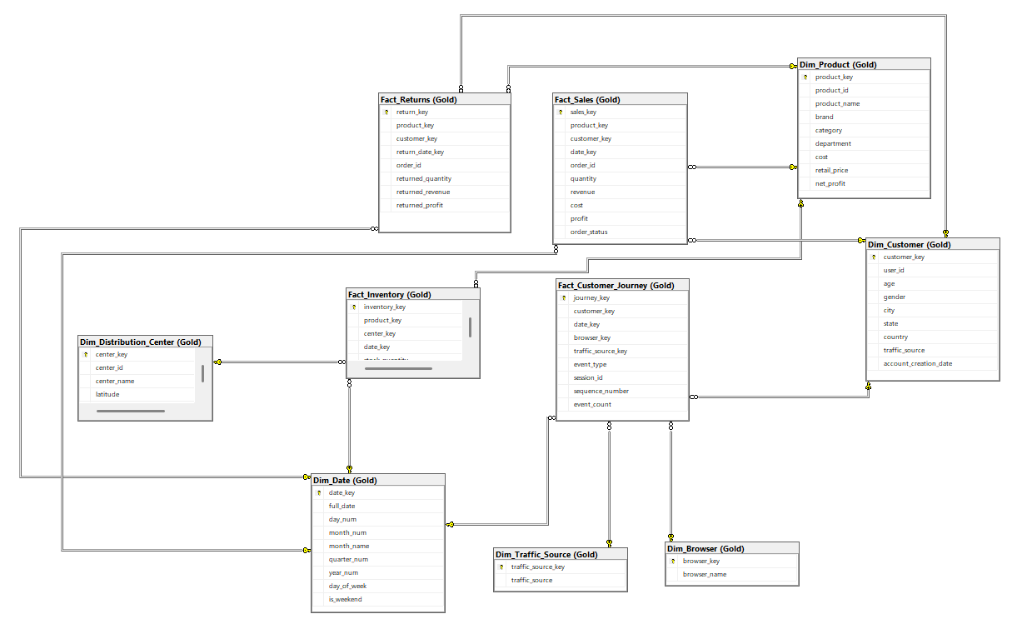
Galaxy schema Design
BRONZE
Raw Data Layer
• Minimal transformation
• SELECT INTO from source
• Historical preservation
• 7 unClean_* tables

Slide 8
ETL Process
Extraction → Cleaning → Transformation → Loading
EXTRACT
testData DB
CLEAN
Remove junk
TRANSFORM
Galaxy model
LOAD
Gold layer
Implementation Details
Automation
• T-SQL Stored Procedures: tables_Bronze, tables_creation, Load_data, Goald_tables
• Automated schema creation and data population
Data Transformation Techniques
• CAST(CAST(id AS FLOAT) AS INT) for type conversion
• ROW_NUMBER() OVER (PARTITION BY...) for deduplication
• SUBSTRING() for date component extraction
• Business logic: net_profit = retail_price - cost

Slide 9
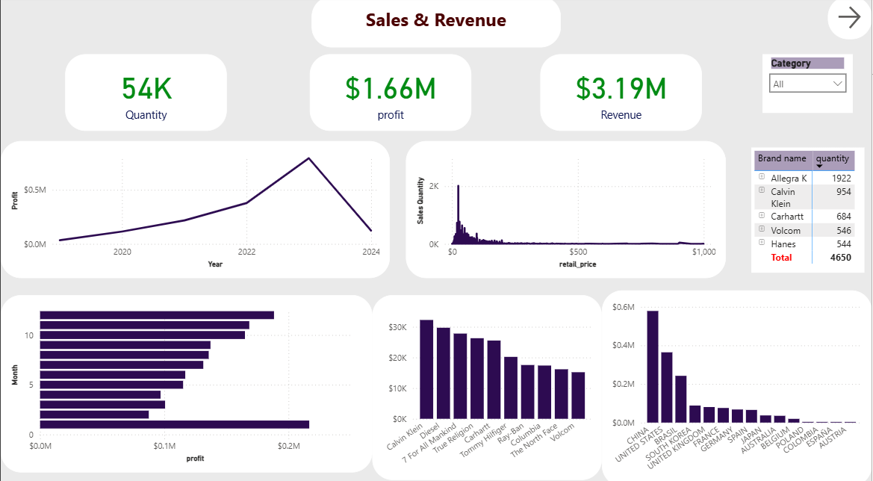
Power BI Dashboard Design

Slide 10
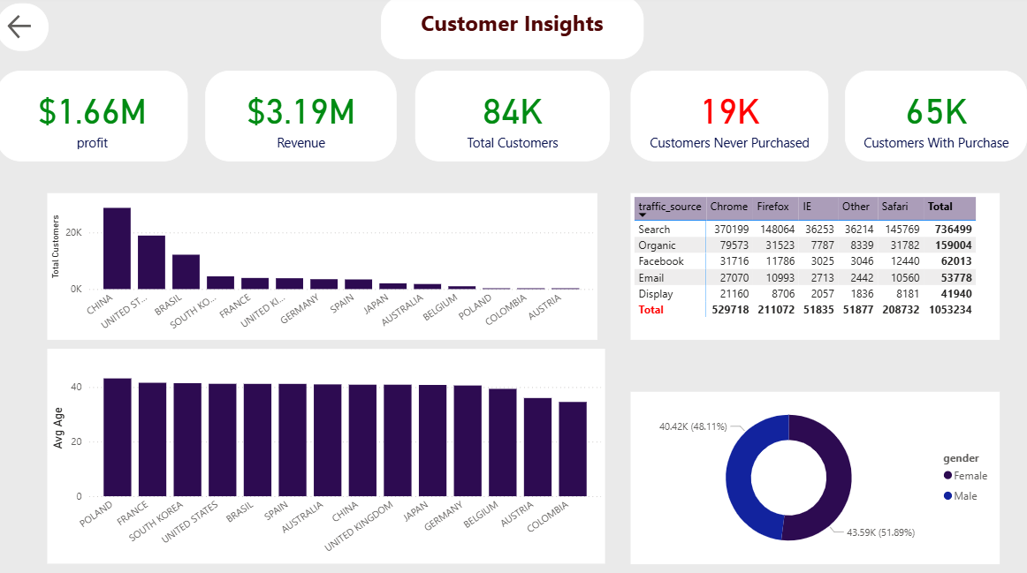
Power BI Dashboard Design

Slide 11
Power BI Dashboard Design
Dashboard Structure & Features
Navigation & Filters
Slicers for Category
Visual Selection Rationale
Bar charts for rankings • Line charts for trends • KPI cards for key metrics • Tables for detailed data
Sales & Revenue Page
Customer Insights Page
KPIs: Quantity, Profit, Revenue
Visuals:
• Line chart: Profitability trend (2019-2024)
• Histogram: Sales by price range
• Bar chart: Top countries by revenue
• Bar chart: Profit by brand
• Table: Top 5 brands by quantity
KPIs: Total, Profit, Revenue, Conversion
Visuals:
• Bar chart: Top countries by customer count
• Bar chart: Average age by country
• Donut chart: Gender distribution
• Table: Traffic source effectiveness
• Table: Browser usage statistics

Slide 12
Data Analysis & Key Insights
Answering business questions using Gold layer in Power BI
Annual Profitability Trend (2020-2024)
Visualization: Line chart showing yearly profit
Insight: Steady growth 2019-2022, peak in 2022-2023, decline in 2024
Action: Investigate 2024 decline - analyze costs, pricing, competition
Sales Distribution by Price Range
Visualization: Histogram/bar chart of price brackets
Insight: Most sales in $0-$100 range, peak at $50-$75
Action: Focus inventory on sweet spot, introduce premium products strategically
Top Revenue Countries
Visualization: Bar chart of countries by revenue
Insight: China ($30K+), United States, South Korea lead
Action: Prioritize these markets for marketing spend & expansion

Slide 13
Customer & Marketing Insights
$1.66M
$3.19M
84K
77%
70%
Total Profit
Revenue
Customers
Conversion
From Search
Customer Analysis
Strategic Actions
Conversion Rate: 77% (65K/84K)
19K registered but never purchased
Demographics
• Nearly equal gender split (48% F / 52% M)
• Average age: 40-50 years
• China leads in customer count
Traffic Sources
• Search: 736K (70%)
• Organic, Facebook, Email follow
Browser Usage
• Chrome, Firefox, IE (top 3)
1. Re-engage Non-Purchasers
Target 19K inactive users with personalized campaigns
2. Optimize Search Marketing
70% traffic from search - double down on SEO/SEM
3. Geographic Focus
Prioritize China, US, Brazil markets
4. Browser Compatibility
Ensure optimal experience on Chrome, Firefox, IE
5. Brand Strategy
Strengthen partnerships with top performers (Speedo, Quiksilve, O'Neill)

Slide 14
Challenges & Solutions
Challenge | Solution | Result
13K+ NULL user_ids in events | DELETE rows + ALTER COLUMN to NOT NULL | Clean event data with referential integrity
Duplicate users (email + name) | ROW_NUMBER() window function deduplication | Unique customer base for analysis
Float IDs requiring integer conversion | CAST(CAST(id AS FLOAT) AS INT) | Proper data types for FK relationships
String timestamps needing parsing | SUBSTRING + date component extraction | Date parts for time-based analysis
Mixed order statuses (incomplete) | Keep only Completed & Returned statuses | Accurate sales & return metrics
No profit calculation available | ADD net_profit = retail_price - cost | Profitability analysis enabled
Complex dimensional model design | Galaxy schema with shared dimensions | Flexible multi-fact analysis
Dashboard clarity & usability | Interactive slicers, clear KPIs, intuitive layout | User-friendly self-service BI

Slide 15
Summary & Key Takeaways
Project Accomplishments
Key Business Insights
• Comprehensive EDA performed
• 3-layer DWH implemented
• Galaxy schema with 3 facts created
• 13K+ records cleaned
• Power BI dashboards built
• Actionable insights delivered
• 77% conversion rate achieved
• 19K re-engagement opportunity
• Search drives 70% of traffic
• $50-$75 price sweet spot
• 2024 decline needs investigation
• Focus on China, US, Brazil markets
Tools & Skills Demonstrated
Technical Skills: SQL Server • T-SQL • Stored Procedures • Window Functions • Data Modeling
Analytical Skills: EDA • Data Cleaning • ETL Design • Galaxy Schema • Business Intelligence
Visualization: Power BI • Dashboard Design • KPI Development • Interactive Reporting

Slide 16
Thank you for your attention

